Slide 1
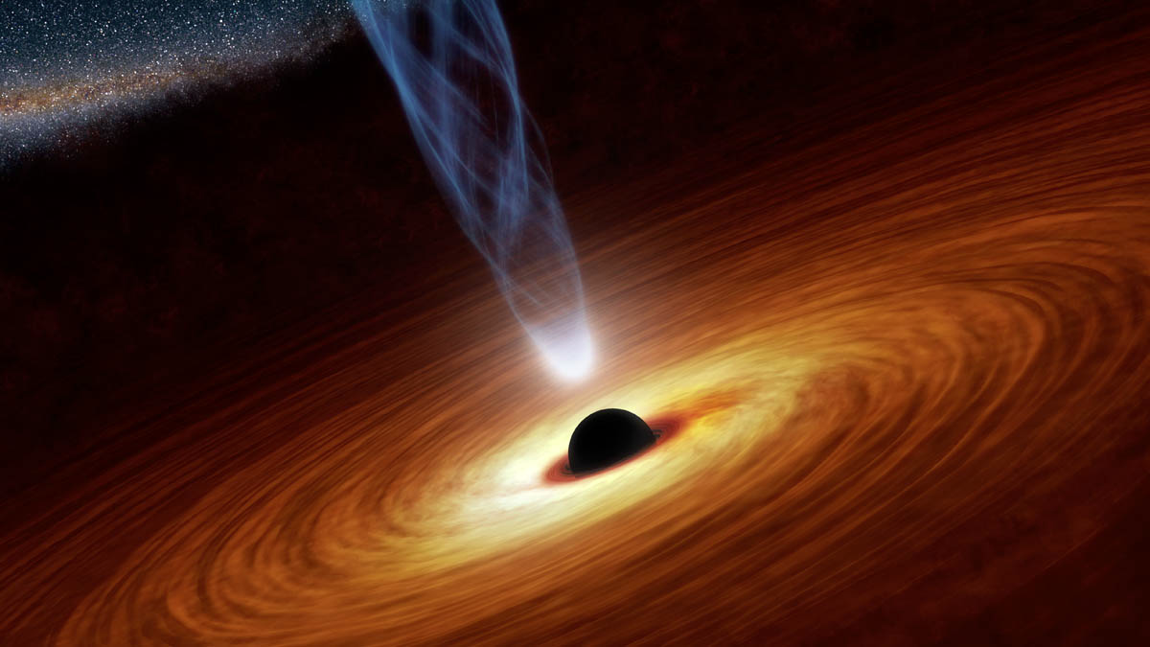
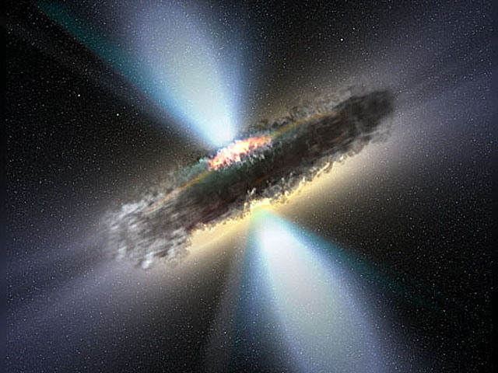
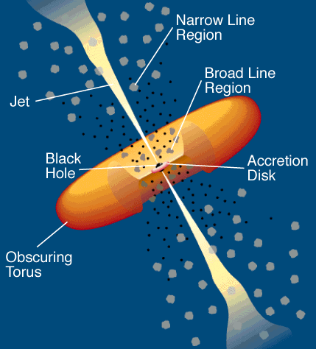
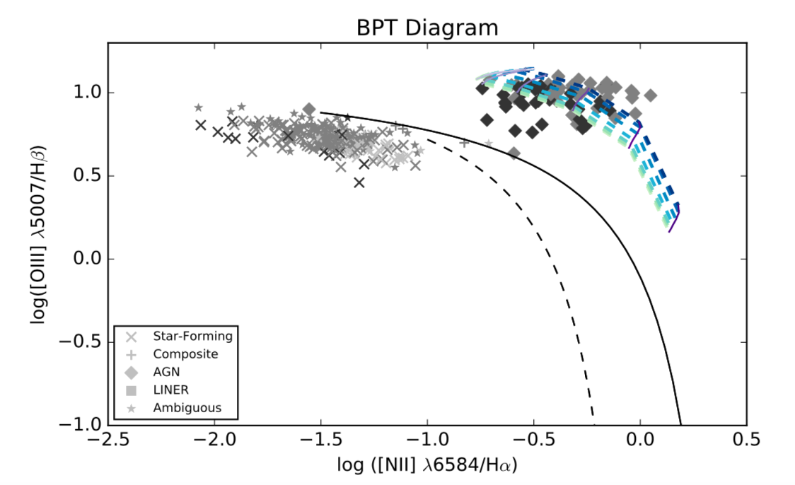
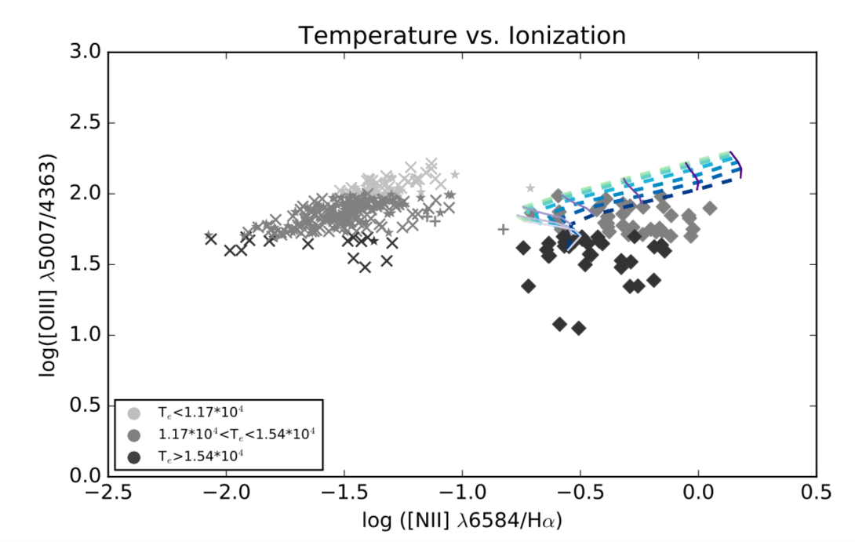
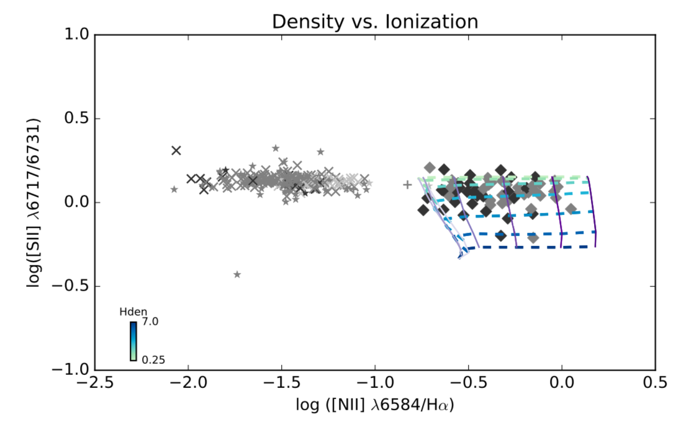


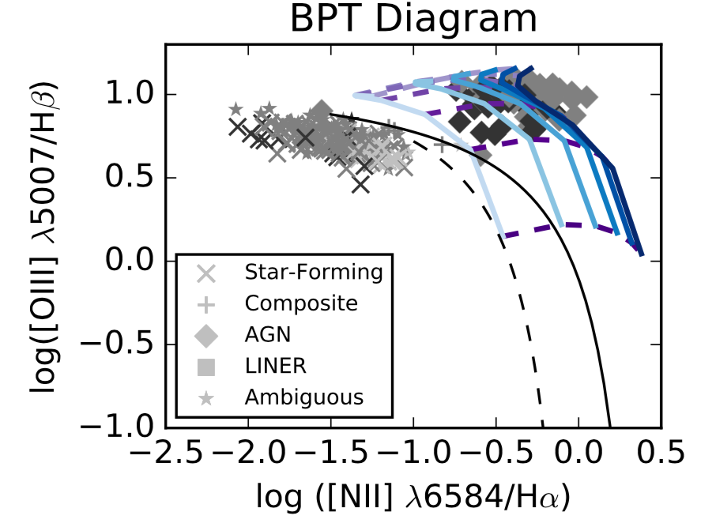
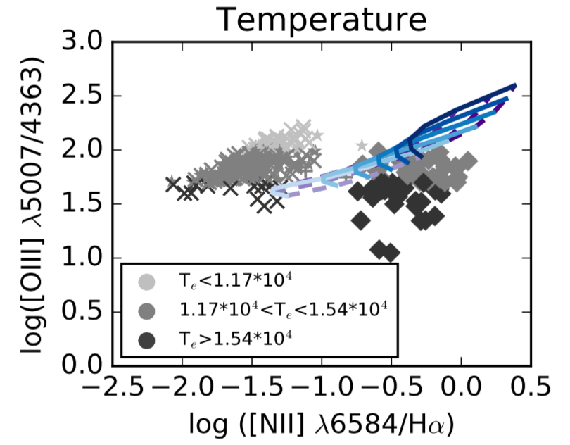
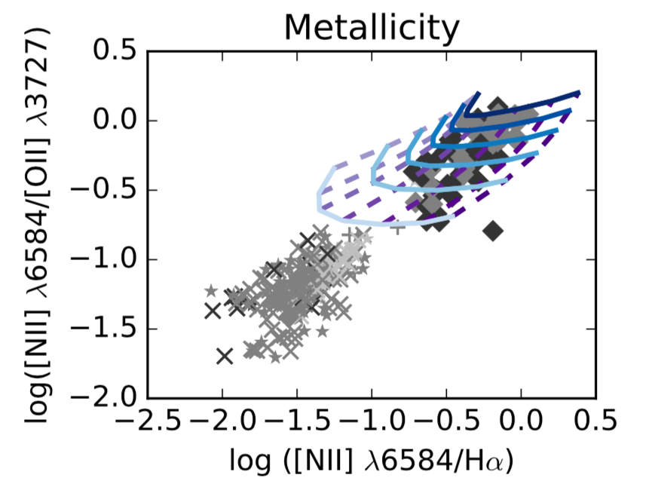
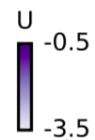
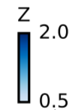
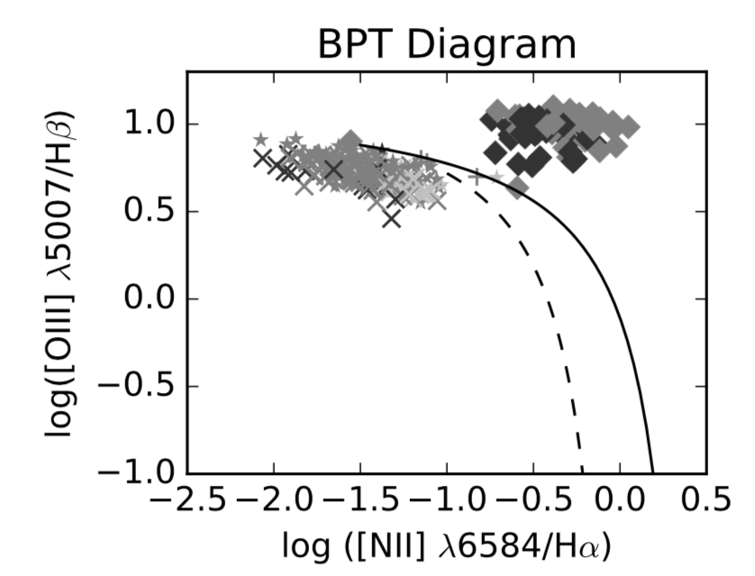
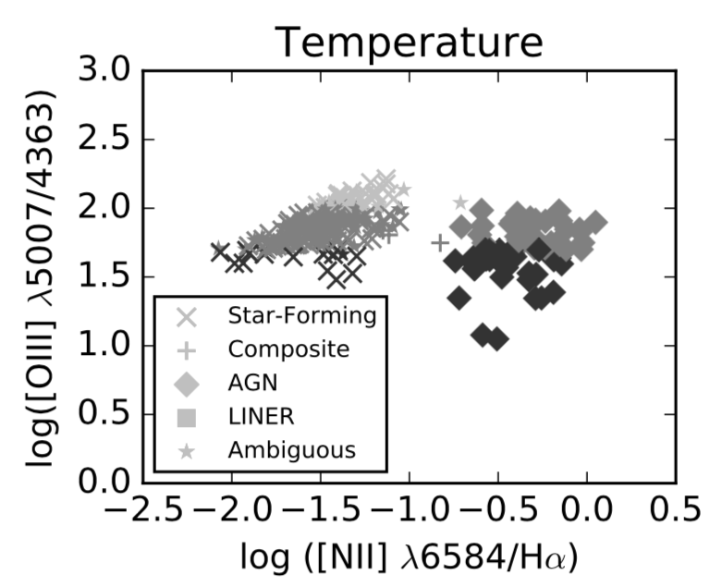
Investigating the Temperature Problem in Narrow Line Emitting AGN
Sam Jenkins, Dr. Chris Richardson
Elon University
Introduction
Results
Anomalously high electron temperature in gas clouds around Narrow Line AGN
Previous attempts at simulating high temperature AGN outliers have been unsuccessful, hence the “temperature problem” (Richardson et al. 2013)
We use a program called CLOUDY to simulate gas clouds with various parameters
-3.5 < U < -0.5 (Purples)
1 < n_{H} < 4 (Green/Blue)
Log Scale
Methods
BPT separates AGN from Star Forming, etc.
Vary ionization from -3.5 to -0.5 on log scale
Sims match large portion of high temperature AGN on BPT Diagram
5007/4363 separates galaxies into temperature categories with highest temperature at lowest ratio
Sims match few high temperature AGN but match ionization value for almost all AGN
Sims match almost all AGN which validates our chosen parameter values
Data set of 200,000 galaxies from Sloan Digital Sky Survey (Albareti et al 2016)
Data filtered to 469 galaxies based on quality of emission lines
Plot this data on diagnostic diagrams to investigate properties
Use CLOUDY to simulate clouds of these galaxies
Simulations run on SDSC Comet cluster, which cut run time from 24 hours to 30-45 minutes
Vary metallicity (Z), ionization parameter (U), grain content and hydrogen density (n_{H}), because of their effects on electron temperature (T_{e}) and ionization, one at a time
Find reasonable ranges of values for each parameter with help from literature (Osterbrock & Ferland 2006)
Varying two at a time to create evenly spaced grid simulations
Plotting these simulations on top of our data
Adjusting simulation parameters to cover high T_{e} AGN on all plots
-3.5 < U < -0.5 (Purples)
0.5 < Z/Z < 2.0 (Blues)
Log Scale
Sims match almost all high temperature AGN
Most high temperature AGN show 0.6 < Z/Z < 1.2
Highest temperature sims match few high temperature AGN but reach higher temperatures than highest temperature n_{H} and U sims
Low metal content produces high T_{e} due to decreased cooling effects
Sims span almost all AGN, including high temperature AGN
Lowest metallicity values start to miss AGN, which matches temperature plot
References
Future Work
Kewley, L., Groves, B., Kauffmann, G., Heckman, T., 2006, MNRAS, 372, 961
Groves, B., Dopita, M., Sutherland, R., 2004, ApJ, 153, 75
Richardson, C., Allen, J., Baldwin, J., Hewett, P., Ferland, G., 2013, MNRAS, 437, 2376
Dopita, M., Sutherland, R., 1995, ApJ, 455, 468
Osterbrock, D., Ferland, G., 2006, Astrophysics of Gaseous Nebulae and Active Galactic Nuclei
Albareti et al., 2016, arXiv: 1608.02013
Acknowledgements
Continue to adjust parameter variations to produce higher temperatures
Begin adjusting free parameters
This project was done as part of Elon University’s Summer Undergraduate Research Experience, Summer 2017. I would like to thank Elon University’s Undergraduate Research Program and my research mentor, Dr. Chris Richardson. This project was conducted with support from XSEDE grant TG-AST140040.

